Slide 1

IDEA CREATION-1
on
QUIZ BUZZ
Batch Number : CS Alpha-04 By
B.Bhavana (2311cs040020) k.Pardhu (2311cs040089) A.Vyshnavi (2311cs040014)
E.Vivek G.Sadhvik
(2311cs040050) (2311cs040062)
Under the Esteemed Guidance of
Mrs.M.V.Sucharitha ( Assistant Professor )

Slide 2

OVERVIEW of the Presentation :-
Abstract
Objectives
Literature Survey
Introduction
Existing System
Propose System
Methodology
Modules of the project
Data Flow Diagram
System Requirements
Screen Shots of the Application
Conclusion

Slide 3

ABSTRACT:
Quiz Buzz is generates new questions and the levels of critical thinking problems is functioned although u can set the difficulty and you can choose interested yet desired topic so that one can focus on the particular subject. We additionally have an option of choosing all subject questions in a single quiz and grades will be stored so that improvement can be regulated on regular basis.
The Quiz Buzz also incorporates diverse question formats, including multiple-choice,
true/false, and open-ended questions, fostering a comprehensive understanding of the subject matter. Additionally, it offers instant feedback and detailed explanations, promoting active learning and addressing misconceptions.

Slide 4

Objective :
The app will offer various types of quizzes, including jee mains, advance, emcet, sports, and general knowledge. Users can choose from a range of topics that interest them. The quiz buzz primary goal is to engage users by challenging their knowledge and curiosity. Well-structured questions and captivating content will keep users coming back for more. The app intends to strike a balance between education and entertainment. Users can learn new facts while enjoying the quiz format. Each quiz will have a limited number of questions to maintain user interest and prevent fatigue. Users will earn credit scores for correct answers. The scoring system encourages participation and healthy competition.

Slide 5

Introduction :
The Quiz buzz Application is an interactive platform designed to challenge users knowledge. Whether you’re a trivia enthusiast or seeking a fun activity, this app caters to diverse interests. Engage, learn, and test your wits with captivating quizzes! This application is not only a valuable tool for educators seeking to personalize assessments but also serves as a self-paced learning platform for individuals. By harnessing the power of adaptability and artificial intelligence, the quiz buzz revolutionizes traditional quiz formats, making learning more efficient, enjoyable, and tailored to the unique needs of each user.

Slide 6

Literature Survey :
"Quiz Show" Documentary: A documentary exploring the infamous quiz show scandals of the 1950s in the United States, shedding light on the darker side of quiz shows.
Online Articles on Trivia Shows: Websites like Mental Floss, BBC, and Buzzfeed often have articles about famous moments in quiz show history, interesting trivia facts, and behind-the-scenes looks at popular quiz programs.
Podcasts: Podcasts like "Good Job, Brain!" and "Ask Me Another" by NPR often feature trivia games, discussions about quiz shows, and interviews with contestants.

Slide 7
Existing System :
The existing quiz generator app allows users to create quizzes manually by inputting questions, answers, and other relevant details. However, it lacks automation and customization features, making it time-consuming for users to create quizzes efficiently.

Slide 8

Proposed System :
The proposed quiz generator app will feature an intuitive user interface where users can input topics and desired difficulty levels, and the app will automatically generate quizzes based on predefined question databases. Additionally, it will offer customization options such as adding images, randomizing question order, and generating answer keys. This system aims to streamline the quiz creation process, saving users time and effort while providing engaging and varied quizzes.

Slide 9

Methodology :
Question Selection: Curated questions covering various categories and difficulty levels.
Gameplay: Buzzers for quick responses, timed rounds, and sometimes multiple-choice questions.
Scoring: Points for correct answers, penalties for incorrect ones.
Prize Structure: Cash prizes or rewards for winners, often escalating.
Research and Development: Pilots and feedback for continuous improvement.

Slide 10

Modules Of The Project :
Creating a quiz project in Java typically involves breaking down the functionality into modules to manage different aspects such as user input, question handling, scoring, etc. Below, I'll outline a basic structure for such a project with some key modules:
Login & Signup Interface Class: This class handles the login and signup interface.
Admin Class: This class represents an admin with username and password.
Admin Manager Class: This class manages admin authentication.
Admin Interface Class: This class handles the admin interface.
Student Class: This class represents a student with username and password.
Student Manager Class: This class manages student authentication.
Student Interface Class: This class handles the student interface.

Slide 11

Data Flow Diagram :

Slide 12

System Requirements :
Software Requirements
XML is used to design structure of the page.
Gradle is used for framework.
SQLlite is used for database of the page.
Java is used for backend of the project

Slide 13
Hardware Requirements
PROCESSOR – Snapdragon 600
RAM – 2GB to 4GB
OS – iOS or Android
STORAGE –50MB

Slide 14
APPLICATION OF CODE:
FRONTEND CODE:
ACTIVITY LOGIN.java
package com.androidapplicationdevelopment.quizbuzzbuildversion;
import androidx.appcompat.app.AppCompatActivity;
import android.content.Intent;
import android.os.Bundle;
import android.view.View;
import android.widget.Button;
import android.widget.TextView;
public class LoginActivity extends AppCompatActivity {
DBhelper DB;
btn.setOnClickListener(new View.OnClickListener() {
@Override
public void onClick(View v) {

Slide 15
startActivity(new Intent(LoginActivity.this,RegistrationActivity.class));
}
});
btnlogin.setOnClickListener(new View.OnClickListener() {
@Override
public void onClick(View v) {
startActivity(new Intent(LoginActivity.this,MainActivity.class));
}
});
btnlogin.setOnClickListener(new View.OnClickListener() {
@Override
public void onClick(View v) {
Intent intent = new Intent(getApplicationContext(), MainActivity.class);
startActivity(intent);
}
});
}
}

Slide 16
ACTIVITY_LOGIN.XML
<?xml version="1.0" encoding="utf-8"?>
<androidx.constraintlayout.widget.ConstraintLayout xmlns:android="http://schemas.android.com/apk/res/android"
xmlns:app="http://schemas.android.com/apk/res-auto"
xmlns:tools="http://schemas.android.com/tools"
android:layout_width="match_parent"
android:layout_height="match_parent"
android:background="@mipmap/background3"
tools:context=".LoginActivity">
<ImageView
android:id="@+id/imageView"
android:layout_width="match_parent"
android:layout_height="wrap_content"
android:layout_marginTop="56dp“
android:layout_marginBottom="42dp"
android:src="@mipmap/applogo"
app:layout_constraintBottom_toTopOf="@+id/textView"
app:layout_constraintTop_toTopOf="parent"
tools:ignore="MissingConstraints"

Slide 17
tools:layout_editor_absoluteX="0dp" />
<TextView
android:id="@+id/textView"
android:layout_width="320dp"
android:layout_height="75dp"
android:layout_marginTop="42dp"
android:drawablePadding="10dp“
android:gravity="center"
android:paddingLeft="20dp"
android:paddingTop="10dp"
android:paddingRight="10dp"
android:paddingBottom="20dp"
android:text="Login"
android:textAllCaps="true"
android:textColor="@color/white"
android:textSize="25dp"
android:textStyle="bold"
app:layout_constraintEnd_toEndOf="parent"
app:layout_constraintHorizontal_bias="0.494"
app:layout_constraintStart_toStartOf="parent"

Slide 18
app:layout_constraintTop_toBottomOf="@+id/imageView"
tools:ignore="MissingConstraints" />
<EditText
android:id="@+id/inputUsername"
android:layout_width="0dp“
android:layout_height="48dp"
android:layout_marginStart="32dp"
android:layout_marginTop="24dp"
android:layout_marginEnd="32dp"
android:background="@drawable/input_bg"
android:drawableLeft="@drawable/ic_email"
android:drawablePadding="10dp"
android:drawableTint="#BB00FF"
android:ems="10"
android:hint="Enter Email Credential"
android:inputType="text"
android:paddingLeft="20dp"
android:paddingTop="10dp"
android:paddingRight="10dp"

Slide 19
android:paddingBottom="10dp"
android:textColor="@color/white"
android:textColorHint="@color/white"
android:textSize="15dp“
app:layout_constraintEnd_toEndOf="parent"
app:layout_constraintHorizontal_bias="1.0"
app:layout_constraintStart_toStartOf="parent"
app:layout_constraintTop_toBottomOf="@+id/textView"
tools:ignore="TextSizeCheck" />
<EditText
android:id="@+id/inputPassword"
android:layout_width="0dp"
android:layout_height="wrap_content"
android:layout_marginTop="32dp"
android:background="@drawable/input_bg" android:drawableLeft="@drawable/ic_confirmpasswordcheck"
android:drawablePadding="10dp"
android:drawableTint="#11FF00"
android:ems="10"
android:hint="Enter Password Credential"

Slide 20
android:inputType="text"
android:minHeight="48dp"
android:paddingLeft="20dp"
android:paddingTop="10dp"
android:paddingRight="10dp"
android:paddingBottom="10dp"
android:textColor="@color/white"
android:textColorHint="@color/white"
android:textSize="15dp"
app:layout_constraintEnd_toEndOf="@+id/inputUsername"
app:layout_constraintStart_toStartOf="@+id/inputUsername"
app:layout_constraintTop_toBottomOf="@+id/inputUsername"
tools:ignore="TextSizeCheck" />
<TextView
android:id="@+id/forgotpassword"
android:layout_width="wrap_content"
android:layout_height="wrap_content"
android:layout_marginStart="32dp"
android:layout_marginTop="16dp"
android:layout_marginEnd="32dp"

Slide 21
android:gravity="center"
android:text="Forgot Password?"
android:textColor="@color/white"
android:textSize="19dp"
android:textStyle="italic"
app:layout_constraintEnd_toEndOf="parent"
app:layout_constraintStart_toStartOf="parent”
app:layout_constraintTop_toBottomOf="@+id/inputPassword"
app:layout_editor_absoluteX="97dp"
tools:ignore="MissingConstraints" />
<Button
android:id="@+id/loginbtn"
android:layout_width="0dp"
android:layout_height="wrap_content"
android:layout_marginStart="32dp"
android:layout_marginTop="20dp"
android:layout_marginEnd="32dp"
android:background="@drawable/btn_bg“
android:text="Login"
android:textColor="@color/black"

Slide 22
android:textSize="20dp"
android:textStyle="italic"
app:layout_constraintEnd_toEndOf="parent“
app:layout_constraintHorizontal_bias="0.0"
app:layout_constraintStart_toStartOf="parent"
app:layout_constraintTop_toBottomOf="@+id/forgotpassword"
tools:ignore="MissingConstraints" />
<LinearLayout
android:id="@+id/linearLayout"
android:layout_width="0dp"
android:layout_height="wrap_content"
android:layout_marginTop="16dp"
android:gravity="center"
android:orientation="horizontal"
android:textAlignment="center“
app:layout_constraintEnd_toEndOf="@+id/loginbtn"
app:layout_constraintHorizontal_bias="0.0"
app:layout_constraintStart_toStartOf="@+id/loginbtn"
app:layout_constraintTop_toBottomOf="@+id/loginbtn">

Slide 23
<TextView
android:layout_width="wrap_content"
android:layout_height="wrap_content"
android:gravity="center"
android:text="I don't have an Account?"
android:textColor="@color/white"
android:textSize="19dp" />
<TextView
android:id="@+id/textViewSignUp"
android:layout_width="wrap_content"
android:layout_height="wrap_content"
android:layout_marginTop="64dp"
android:text="By Malla Reddy University Students"
android:textSize="22dp"
android:textStyle="italic“
app:layout_constraintBottom_toBottomOf="parent"
app:layout_constraintEnd_toEndOf="parent"
app:layout_constraintHorizontal_bias="0.463"
app:layout_constraintStart_toStartOf="parent"

Slide 24
app:layout_constraintTop_toBottomOf="@+id/linearLayout“ app:layout_constraintVertical_bias="0.824" />
</androidx.constraintlayout.widget.ConstraintLayout>
REGISTRATION ACTIVITY.java
package com.androidapplicationdevelopment.quizbuzzbuildversion;
import androidx.appcompat.app.AppCompatActivity;
import android.annotation.SuppressLint;
import android.content.Intent;
import android.os.Bundle;
import android.view.View;
import android.widget.Button;
import android.widget.EditText;
import android.widget.TextView;
import android.widget.Toast;
public class RegistrationActivity extends AppCompatActivity {

Slide 25
DBhelper DB;
TextView btn;
private EditText inputUsername, inputPassword, inputEmail, inputConformPassword;
Button btnRegister;
@SuppressLint("MissingInflatedId")
@Override
protected void onCreate(Bundle savedInstanceState) {
super.onCreate(savedInstanceState);
setContentView(R.layout.activity_registration);
btn = findViewById(R.id.alreadyhaveAccount);
inputUsername = findViewById(R.id.inputUsername);
inputEmail = findViewById(R.id.inputEmail);
inputPassword = findViewById(R.id.inputPassword);
inputConformPassword = findViewById(R.id.inputConformPassword);
DB = new DBhelper(this);
btnRegister = findViewById(R.id.btnRegister);

Slide 26
btnRegister.setOnClickListener(new View.OnClickListener() {
@Override
public void onClick(View view) {
checkCredentials();
}
});
btn.setOnClickListener(new View.OnClickListener() {
@Override
public void onClick(View v) {
startActivity(new Intent(RegistrationActivity.this, LoginActivity.class));
}
});
}
private void checkCredentials() {
String username = inputUsername.getText().toString();
String email = inputEmail.getText().toString();
String password = inputPassword.getText().toString();

Slide 27
String conformpassword = inputConformPassword.getText().toString();
if (username.equals("") || password.equals("") || email.equals("") || conformpassword.equals(""))
Toast.makeText(RegistrationActivity.this, "Please Enter All Fields", Toast.LENGTH_SHORT).show();
else {
if (password.equals(conformpassword)) {
Boolean checkuser = DB.checkusername(username);
if (checkuser == false) {
Boolean insert = DB.insertData(username, password);
if (insert == true) {
Toast.makeText(RegistrationActivity.this, "Registration Success", Toast.LENGTH_SHORT).show();
Intent intent = new Intent(getApplicationContext(), LoginActivity.class);
startActivity(intent);
} else {
Toast.makeText(RegistrationActivity.this, "Registration Failure (Something Went Wrong)",
Toast.LENGTH_SHORT).show();
}
} else {

Slide 28
Toast.makeText(RegistrationActivity.this, "User Already Exists! Please Login Back", Toast.LENGTH_SHORT).show();
}
} else {
Toast.makeText(RegistrationActivity.this, "Incorrect Password (MissMatching Error)", Toast.LENGTH_SHORT).show();
}
}
}
}
Activity_registration.xml
<?xml version="1.0" encoding="utf-8"?>
<androidx.constraintlayout.widget.ConstraintLayout xmlns:android="http://schemas.android.com/apk/res/android"
xmlns:app="http://schemas.android.com/apk/res-auto"
xmlns:tools="http://schemas.android.com/tools"
android:layout_width="match_parent"
android:layout_height="match_parent"
tools:layout_editor_absoluteX="0dp" />

Slide 29
android:background="@mipmap/background3"
tools:context=".RegistrationActivity">
<ImageView
android:id="@+id/imageView"
android:layout_width="match_parent"
android:layout_height="wrap_content"
android:layout_marginTop="24dp"
android:src="@mipmap/applogo"
app:layout_constraintTop_toTopOf="parent"
tools:ignore="MissingConstraints“
tools:layout_editor_absoluteX="0dp" />
<TextView
android:id="@+id/textView"
android:layout_width="320dp"
android:layout_height="75dp"
android:layout_marginTop="32dp"

Slide 30
android:layout_marginBottom="16dp"
android:drawablePadding="10dp"
android:gravity="center"
android:paddingLeft="20dp"
android:paddingTop="10dp"
android:paddingRight="10dp"
android:paddingBottom="20dp"
android:text="Registration"
android:textAllCaps="true“
android:textColor="@color/white"
android:textSize="25dp"
android:textStyle="italic"
app:layout_constraintBottom_toTopOf="@+id/inputUsername"
app:layout_constraintEnd_toEndOf="parent"
app:layout_constraintStart_toStartOf="parent"
app:layout_constraintTop_toBottomOf="@+id/imageView"
tools:ignore="MissingConstraints" />

Slide 31
<EditText
android:id="@+id/inputUsername"
android:layout_width="0dp"
android:layout_height="48dp"
android:layout_marginStart="32dp"
android:layout_marginTop="16dp"
android:layout_marginEnd="32dp"
android:background="@drawable/input_bg"
android:drawableLeft="@drawable/ic_person"
android:drawablePadding="10dp"
android:drawableTint="#A600FF"
android:ems="10"
android:textColorHint="@color/white"
android:hint="Enter Unique Username"
android:inputType="text“
android:paddingLeft="20dp"
android:paddingTop="10dp"

Slide 32
android:paddingRight="10dp"
android:paddingBottom="10dp"
android:textColor="@color/white"
android:textSize="15dp"
app:layout_constraintEnd_toEndOf="parent"
app:layout_constraintStart_toStartOf="parent"
app:layout_constraintTop_toBottomOf="@+id/textView"
tools:ignore="TextSizeCheck" />
<EditText
android:id="@+id/inputEmail"
android:layout_width="0dp"
android:layout_height="wrap_content"
android:layout_marginTop="16dp"
android:background="@drawable/input_bg"
android:drawableLeft="@drawable/ic_email"
android:drawablePadding="10dp"
android:drawableTint="#00FFE1"

Slide 33
android:ems="10"
android:textColorHint="@color/white"
android:hint="Enter Authorised Email Address"
android:inputType="text"
android:minHeight="48dp"
android:paddingLeft="20dp"
android:paddingTop="10dp"
android:paddingRight="10dp"
android:paddingBottom="10dp"
android:textColor="@color/white"
android:textSize="15dp"
app:layout_constraintEnd_toEndOf="@+id/inputUsername"
app:layout_constraintStart_toStartOf="@+id/inputUsername"
app:layout_constraintTop_toBottomOf="@+id/inputUsername"
tools:ignore="TextSizeCheck" />
<EditText
android:id="@+id/inputPassword"

Slide 34
android:layout_width="0dp"
android:layout_height="wrap_content"
android:layout_marginTop="16dp“
android:background="@drawable/input_bg"
android:drawableLeft="@drawable/ic_passwordcheck"
android:drawablePadding="10dp"
android:drawableTint="#FF0000"
android:ems="10"
android:textColorHint="@color/white"
android:hint="Enter Unique Password"
android:inputType="text"
android:minHeight="48dp"
android:paddingLeft="20dp"
android:paddingTop="10dp"
android:paddingRight="10dp"
android:paddingBottom="10dp"
android:textColor="@color/white"

Slide 35
android:textSize="15dp"
app:layout_constraintEnd_toEndOf="@+id/inputEmail"
app:layout_constraintStart_toStartOf="@+id/inputEmail"
app:layout_constraintTop_toBottomOf="@+id/inputEmail"
tools:ignore="TextSizeCheck" />
<EditText
android:id="@+id/inputConformPassword"
android:layout_width="0dp"
android:layout_height="wrap_content"
android:layout_marginTop="16dp"
android:background="@drawable/input_bg"
android:drawableLeft="@drawable/ic_confirmpasswordcheck"
android:drawablePadding="10dp"
android:drawableTint="#11FF00"
android:ems="10"
android:hint="Re-Enter Your Unique Password"

Slide 36
android:inputType="text"
android:minHeight="48dp"
android:paddingLeft="20dp"
android:paddingTop="10dp"
android:paddingRight="10dp"
android:paddingBottom="10dp"
android:textColor="@color/white"
android:textColorHint="@color/white"
android:textSize="15dp"
app:layout_constraintEnd_toEndOf="@+id/inputPassword"
app:layout_constraintStart_toStartOf="@+id/inputPassword"
app:layout_constraintTop_toBottomOf="@+id/inputPassword"
tools:ignore="TextSizeCheck" />
<TextView
android:id="@+id/alreadyhaveAccount“
android:layout_width="wrap_content"
android:layout_height="wrap_content"

Slide 37
android:layout_marginStart="97dp"
android:layout_marginTop="20dp"
android:layout_marginEnd="97dp"
android:layout_marginBottom="23dp"
android:text="Already Have An Account?"
android:textColor="@color/green"
android:textSize="19dp"
android:textStyle="italic“ app:layout_constraintBottom_toTopOf="@+id/btnRegister"
app:layout_constraintEnd_toEndOf="parent"
app:layout_constraintStart_toStartOf="parent"
app:layout_constraintTop_toBottomOf="@+id/inputConformPassword"
tools:ignore="MissingConstraints" />
<Button
android:id="@+id/btnRegister"
android:layout_width="0dp"

Slide 38
android:layout_height="wrap_content"
android:layout_marginStart="32dp"
android:layout_marginTop="23dp"
android:layout_marginEnd="32dp"
android:layout_marginBottom="167dp"
android:background="@drawable/btn_bg"
android:gravity="center"
android:paddingLeft="20dp"
android:paddingTop="10dp"
android:paddingRight="10dp"
android:paddingBottom="10dp"
android:text="REGISTER"
android:textColor="@color/black"
android:textSize="15dp"
android:textStyle="italic"
app:layout_constraintBottom_toBottomOf="parent"

Slide 39
app:layout_constraintTop_toBottomOf="@+id/alreadyhaveAccount"
tools:ignore="TextSizeCheck" />
<TextView
android:id="@+id/bytext"
android:layout_width="wrap_content"
android:layout_height="wrap_content"
android:text="By Malla Reddy University Students"
android:textColor="@color/white"
android:textSize="22dp"
android:textStyle="italic"
app:layout_constraintBottom_toBottomOf="parent"
app:layout_constraintEnd_toEndOf="parent"
app:layout_constraintStart_toStartOf="parent"
app:layout_constraintTop_toBottomOf="@+id/btnRegister" />
</androidx.constraintlayout.widget.ConstraintLayout>

Slide 40
MAIN ACTIVITY.java
package com.androidapplicationdevelopment.quizbuzzbuildversion;
import androidx.appcompat.app.AppCompatActivity;
import android.annotation.SuppressLint;
import android.content.DialogInterface;
import android.content.Intent;
import android.os.Bundle;
import android.view.View;
import com.google.android.material.card.MaterialCardView;
import com.google.android.material.dialog.MaterialAlertDialogBuilder;
public class MainActivity extends AppCompatActivity {
public MaterialCardView easycard, mediumcard, toughcard, aboutcard;
@Override
protected void onCreate(Bundle savedInstanceState) {
super.onCreate(savedInstanceState);
setContentView(R.layout.activity_main);
easycard = (MaterialCardView) findViewById(R.id.easyCard);

Slide 41
mediumcard = (MaterialCardView) findViewById(R.id.mediumCard);
toughcard = (MaterialCardView) findViewById(R.id.toughCard);
aboutcard = (MaterialCardView) findViewById(R.id.aboutCard);
easycard.setOnClickListener(new View.OnClickListener() {
@Override
public void onClick(View v) {
startActivity(new Intent(MainActivity.this, EasyBuzzer.class));
}
});
}
@Override
public void onBackPressed () {
MaterialAlertDialogBuilder materialAlertDialogBuilder = new MaterialAlertDialogBuilder(MainActivity.this);
materialAlertDialogBuilder.setTitle(R.string.app_name);
materialAlertDialogBuilder.setMessage("Are you sure want to exit the app?");
materialAlertDialogBuilder.setNegativeButton(android.R.string.no, new DialogInterface.OnClickListener() {

Slide 42
@Override
public void onClick(DialogInterface dialogInterface, int i) {
dialogInterface.dismiss();
}
});
materialAlertDialogBuilder.setPositiveButton(android.R.string.yes, new DialogInterface.OnClickListener() {
@Override
public void onClick(DialogInterface dialogInterface, int i) {
finish();
}
});
materialAlertDialogBuilder.show();
super.onBackPressed();
}
@SuppressLint("CustomSplashScreen")
public static class SplashActivity extends AppCompatActivity {

Slide 43
@Override
protected void onCreate(Bundle savedInstanceState) {
super.onCreate(savedInstanceState);
setContentView(R.layout.activity_splash);
Thread mSplashThread;
mSplashThread = new Thread() {
@Override
public void run() {
try {
synchronized (this) {
wait(2000);
}
} catch (InterruptedException ignored) {
} finally {
startActivity(new Intent(getApplicationContext(), com.androidapplicationdevelopment.quizbuzzbuildversion.MainActivity.class));
finish();

Slide 44
}
}
};
mSplashThread.start();
}
}
}
ACTIVITY_MAIN.XML
<?xml version="1.0" encoding="utf-8"?>
<androidx.constraintlayout.widget.ConstraintLayout xmlns:android="http://schemas.android.com/apk/res/android"
xmlns:app="http://schemas.android.com/apk/res-auto"
xmlns:tools="http://schemas.android.com/tools"
android:layout_width="match_parent"

Slide 45
android:layout_height="match_parent"
android:background="@color/black"
tools:context=".MainActivity">
<androidx.core.widget.NestedScrollView
android:id="@+id/nestedScrollView"
android:layout_width="match_parent"
android:layout_height="0dp"
android:background="@mipmap/background3"
app:layout_behavior="@string/appbar_scrolling_view_behavior"
app:layout_constraintBottom_toBottomOf="parent"
app:layout_constraintEnd_toEndOf="parent"
app:layout_constraintHorizontal_bias="1.0"
app:layout_constraintStart_toStartOf="parent"
app:layout_constraintTop_toBottomOf="@id/appbarLayout">
<LinearLayout
android:layout_width="match_parent"
android:layout_height="match_parent"
android:orientation="vertical">

Slide 46
<ImageView
android:layout_width="match_parent"
android:layout_height="91dp"
android:layout_gravity="center"
android:src="@mipmap/applogo_round" />
<com.google.android.material.card.MaterialCardView
android:id="@+id/easyCard"
android:layout_width="match_parent"
android:layout_height="wrap_content"
android:layout_marginStart="25dp"
android:layout_marginTop="25dp"
android:layout_marginEnd="25dp"
app:cardBackgroundColor="@color/card_background"
app:cardCornerRadius="25dp“
app:strokeWidth="0dp">
<LinearLayout
android:layout_width="match_parent"

Slide 47
SPLASH ACTIVITY.java
package com.androidapplicationdevelopment.quizbuzzbuildversion;
import androidx.appcompat.app.AppCompatActivity;
import android.content.Intent;
import android.os.Bundle;
public class SplashActivity extends AppCompatActivity {
@Override
protected void onCreate(Bundle savedInstanceState) {
super.onCreate(savedInstanceState);
setContentView(R.layout.activity_splash);
Thread mSplashThread;
mSplashThread = new Thread() {
@Override public void run() {
try {
synchronized (this) {
wait(2000);
}

Slide 48
} catch (InterruptedException ignored) {
}
finally {
startActivity(new Intent(getApplicationContext(), RegistrationActivity.class));
finish();
}
}
};
mSplashThread.start();
}
}
ACTIVITY_SPLASH.XML
<?xml version="1.0" encoding="utf-8"?>
<androidx.constraintlayout.widget.ConstraintLayout xmlns:android="http://schemas.android.com/apk/res/android"
xmlns:app="http://schemas.android.com/apk/res-auto"

Slide 49
xmlns:tools="http://schemas.android.com/tools"
android:layout_width="match_parent"
android:layout_height="match_parent"
android:background="@color/black"
tools:context="com.androidapplicationdevelopment.quizbuzzbuildversion.SplashActivity"
tools:ignore="MissingClass">
<androidx.constraintlayout.widget.ConstraintLayout
android:id="@+id/backgroundLayout"
android:layout_width="200dp"
android:layout_height="200dp"
app:layout_constraintBaseline_toBottomOf="parent"
app:layout_constraintBottom_toBottomOf="parent"
app:layout_constraintEnd_toEndOf="parent"
app:layout_constraintStart_toStartOf="parent“
app:layout_constraintTop_toTopOf="parent" />
<LinearLayout
android:layout_width="match_parent"

Slide 50
android:layout_height="match_parent"
android:background="@mipmap/background3"
android:gravity="center"
android:orientation="vertical"
app:layout_constraintStart_toEndOf="@+id/backgroundLayout"
tools:layout_editor_absoluteY="16dp">
<ImageView
android:layout_width="100dp"
android:layout_height="100dp"
android:src="@mipmap/applogo"
tools:src="@mipmap/applogo" />
<TextView
android:layout_width="match_parent"
android:layout_height="wrap_content"
android:layout_marginTop="20sp"
</LinearLayout>
</androidx.constraintlayout.widget.ConstraintLayout>

Slide 51
BACK-END CODE
DB HELPER (database)
package com.androidapplicationdevelopment.quizbuzzbuildversion;
import android.content.ContentValues;
import android.content.Context;
import android.database.Cursor;
import android.database.sqlite.SQLiteDatabase;
import android.database.sqlite.SQLiteOpenHelper;
import androidx.annotation.Nullable;
public class DBhelper extends SQLiteOpenHelper {
public static final String DBNAME = "Login.DB";
public DBhelper(Context context) {
super(context, "Login.DB", null, 1);
}

Slide 52
@Override
public void onCreate(SQLiteDatabase MyDB) {
MyDB.execSQL("create Table users(username TEXT primary key, password TEXT)");
}
@Override
public void onUpgrade(SQLiteDatabase MyDB, int oldVersion, int newVersion) {
MyDB.execSQL("drop Table if exists users");
}
public Boolean insertData(String username, String password) {
SQLiteDatabase MyDB = this.getWritableDatabase();
ContentValues contentValues = new ContentValues();
contentValues.put("username", username);
contentValues.put("password", password);
long result = MyDB.insert("users", null, contentValues);
if (result == -1) return false;
else
return true;

Slide 53
else
return false;
}
public Boolean checkusernamepassword(String username, String password) {
SQLiteDatabase MyDB = this.getWritableDatabase();
Cursor cursor = MyDB.rawQuery("Select * from users where username = ? and password = ?", new String[]{username, password});
if (cursor.getCount() > 0)
return true;
else
return false;
}
}
QuestionItems.java
package com.androidapplicationdevelopment.quizbuzzbuildversion;
public class QuestionsItem {
String questions,answer1,answer2, answer3, answer4, correct;
public QuestionsItem(String questions, String answer1, String answer2, String answer3, String answer4, String correct) {

Slide 54
this.questions = questions;
this.answer1 = answer1;
this.answer2 = answer2;
this.answer3 = answer3;
this.answer4 = answer4;
this.correct = correct;
}
public String getQuestions() {
return questions;
}
public void setQuestions(String questions) {
this.questions = questions;
}
public String getAnswer1() {
return answer1;
}
public void setAnswer1(String answer1) {
this.answer1 = answer1;

Slide 55
}
public String getAnswer2() {
return answer2;
}
public void setAnswer2(String answer2) {
this.answer2 = answer2;
}
public String getAnswer3() {
return answer3;
}
public String getCorrect() {
return correct;
}
public void setCorrect(String correct) {
this.correct = correct;
}
}

Slide 56
AndroidManifest.xml (Manifestation File)
<?xml version="1.0" encoding="utf-8"?>
<manifest xmlns:android="http://schemas.android.com/apk/res/android"
xmlns:tools="http://schemas.android.com/tools">
<application
android:allowBackup="true"
android:dataExtractionRules="@xml/data_extraction_rules"
android:fullBackupContent="@xml/backup_rules"
android:icon="@mipmap/applogo"
android:label="@string/app_name"
android:roundIcon="@mipmap/applogo_round"
android:supportsRtl="true"
android:theme="@style/Base.Theme.QuizBuzzBuildVersion"
tools:targetApi="31">
<activity
android:name=".ResultActivity"
android:exported="false" />

Slide 57
<activity
android:name=".EasyBuzzer"
android:exported="true">
<intent-filter>
<action android:name="com.androidapplicationdevelopment.quizbuzzbuildversion.EASY_BUZZER" />
<category android:name="android.intent.category.DEFAULT" />
</intent-filter>
</activity>
<activity
android:name=".MediumBuzzer"
android:exported="true">
<intent-filter>
<action android:name="com.androidapplicationdevelopment.quizbuzzbuildversion.MEDIUM_BUZZER" />
<category android:name="android.intent.category.DEFAULT" />
</intent-filter>
</activity>
<activity

Slide 58
android:name=".ToughBuzzer"
android:exported="true">
<intent-filter>
<action android:name="com.androidapplicationdevelopment.quizbuzzbuildversion.TOUGH_BUZZER" />
<category android:name="android.intent.category.DEFAULT" />
</intent-filter>
</activity>
<activity
android:name=".LoginActivity"
android:exported="true">
<intent-filter>
<action android:name="android.intent.action.MAIN" />
<category android:name="android.intent.category.LAUNCHER" />
</intent-filter>
</activity>

Slide 59
<activity
android:name=".RegistrationActivity"
android:exported="true" />
<activity
android:name=".SplashActivity"
android:exported="true" />
<activity
android:name=".MainActivity"
android:exported="true" />
</application>
</manifest>

Slide 60
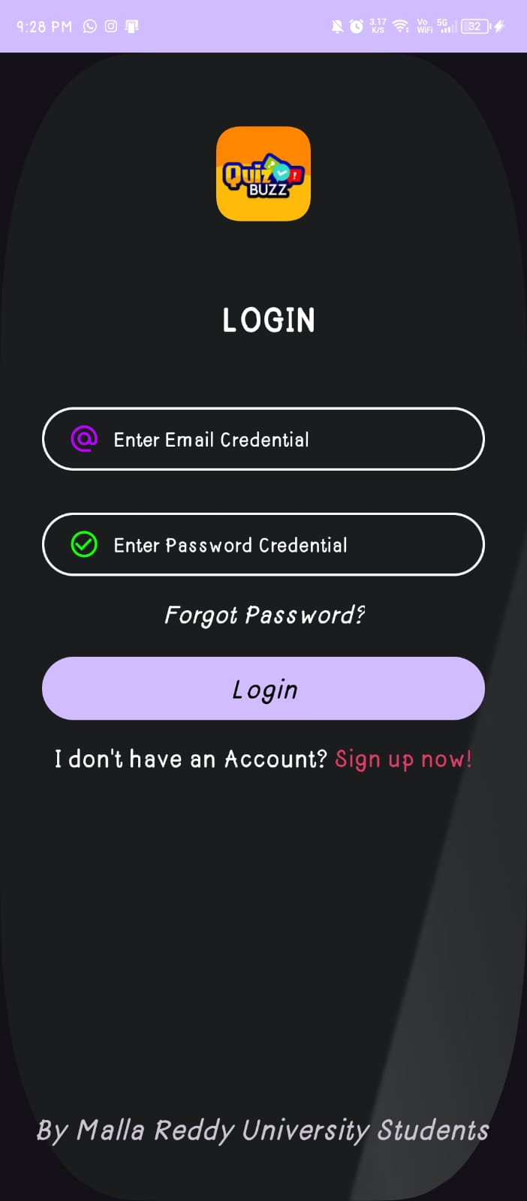
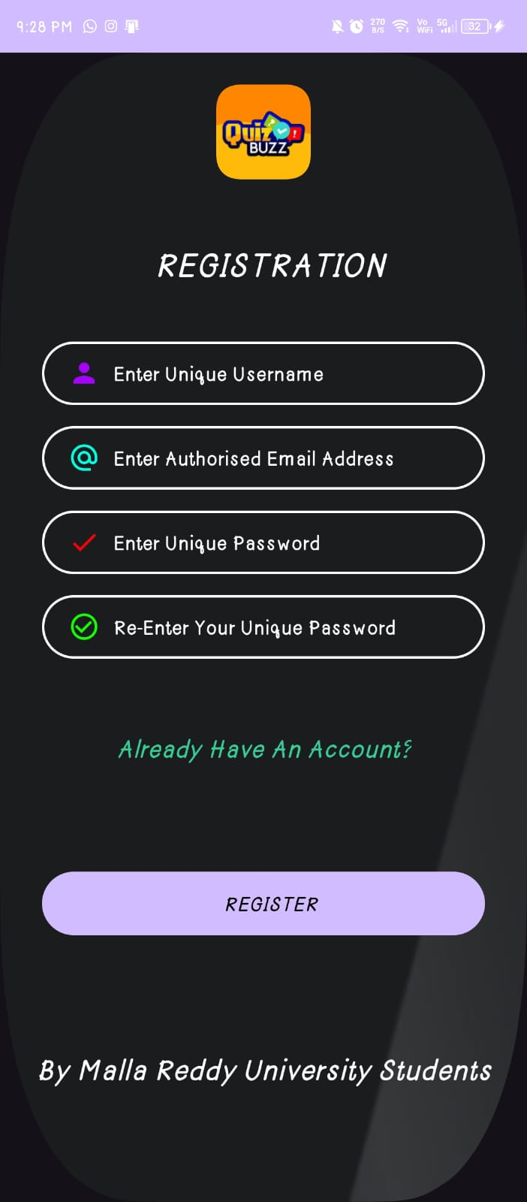
SCREEN SHOTS OF THE APPLICATION (LOGIN & REGISTRATION PAGE)

Slide 61
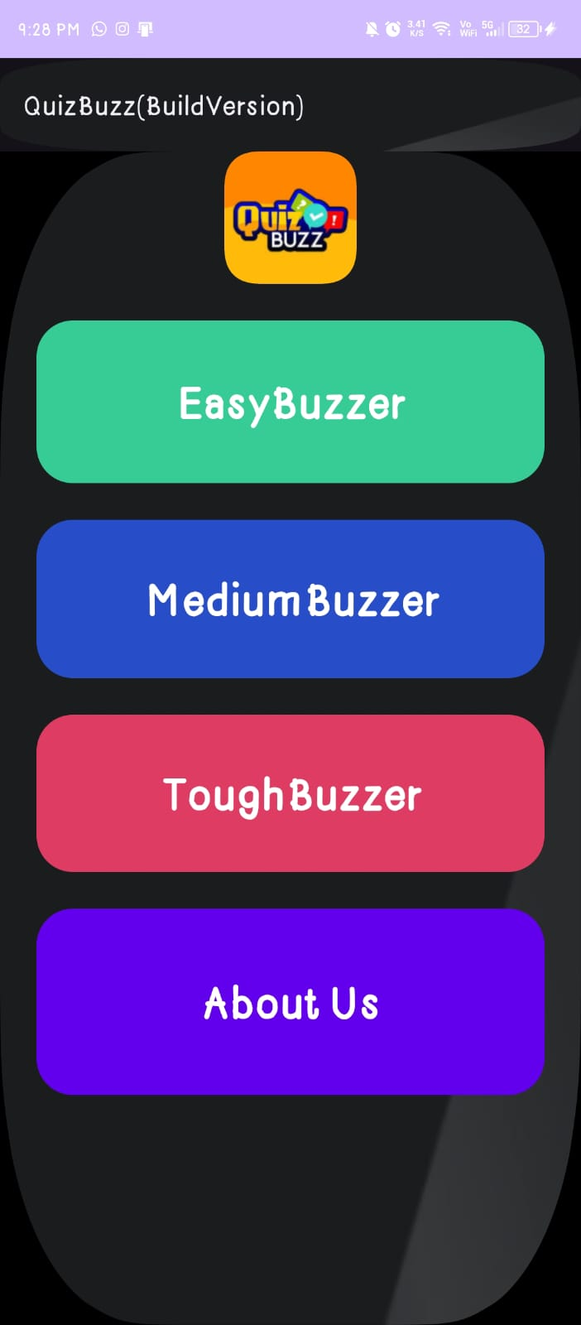
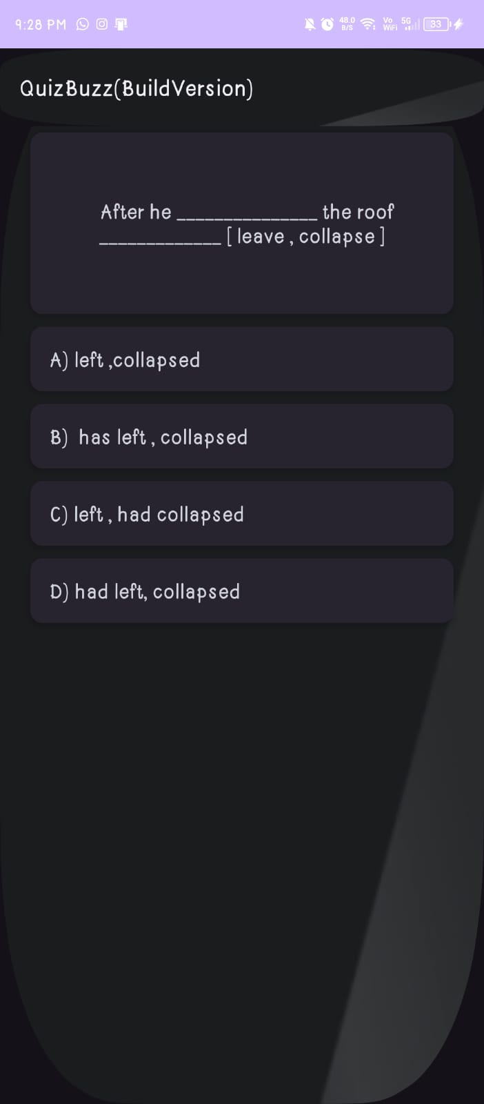
SCREEN SHOTS OF THE APPLICATION (HOME & APP PAGE)

Slide 62

Conclusion :
The quiz buzz app provides a versatile platform for creating engaging and interactive quizzes. Its user-friendly interface allows users to easily generate quizzes tailored to their specific needs, whether for educational purposes, training sessions, or recreational activities. The app's customizable features, such as question types, difficulty levels, and multimedia integration, enhance the overall learning experience and cater to diverse audiences. The app's compatibility across multiple devices further increases accessibility, enabling users to take quizzes anytime, anywhere. Overall, the quiz buzz app offers a valuable tool for educators, trainers, and quiz enthusiasts alike, fostering knowledge retention, skills development, and enjoyment. With continuous updates and improvements, it has the potential to further enhance learning experiences and become a staple tool in various educational and professional settings.

Slide 63


